Slide 1
Mathematical Foundations for Data Science
MFDS Team

Slide 2
DSECL ZC416, MFDS
Lecture No. 16

Slide 3
Agenda
Generating functions
Extended binomial theorem
Counting problems and generating functions
Solving recurrence relations using generating functions
Proving Identities via Generating Functions

Slide 4
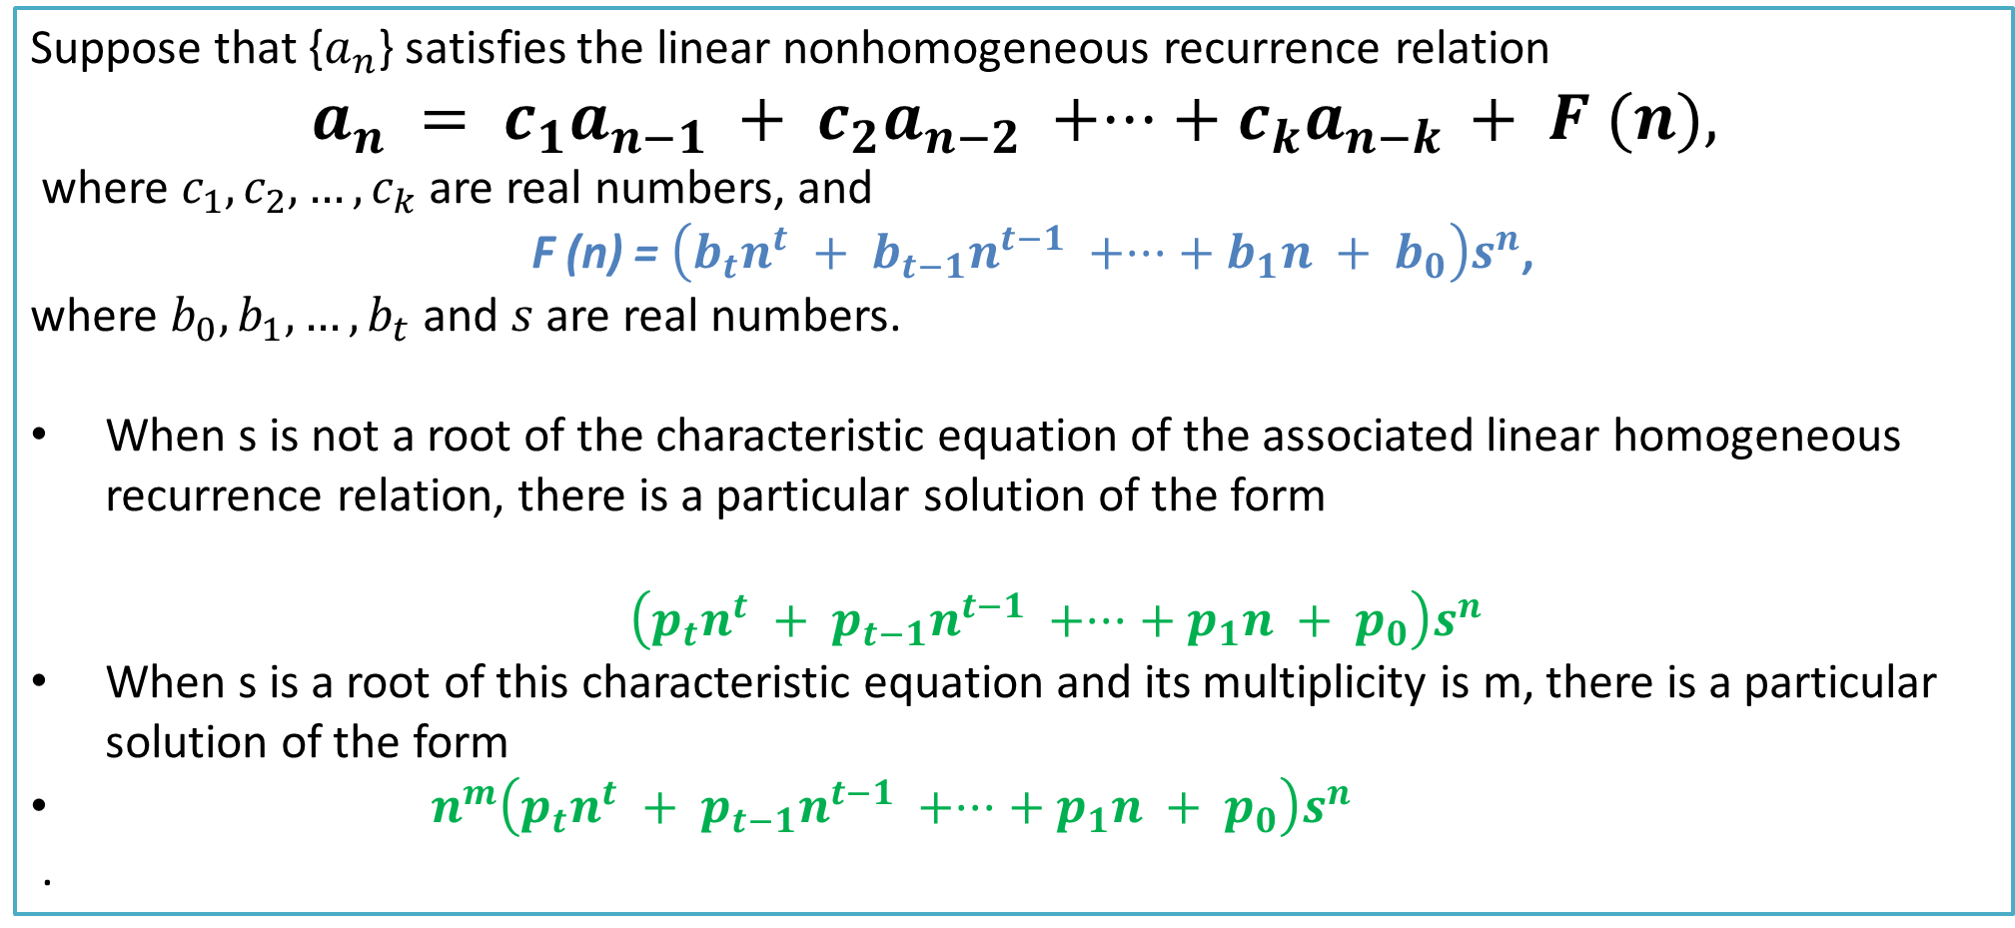
Theorem 6
Suppose that {$a_{n}$} satisfies the linear nonhomogeneous recurrence relation
$$a_{n} = c_{1}a_{n−1} + c_{2}a_{n−2} +···+ c_{k}a_{n−k }+ F (n),$$
where $c_{1}, c_{2},…,c_{k}$are real numbers, and
F (n) = $\left(b_{t}n^{t} + b_{t−1}n^{t−1} +···+ b_{1}n + b_{0}\right)s^{n}$,
where $b_{0}, b_{1},…,b_{t}$and $s$ are real numbers.
When s is not a root of the characteristic equation of the associated linear homogeneous recurrence relation, there is a particular solution of the form
$\left(p_{t}n^{t} + p_{t−1}n^{t−1} +···+ p_{1}n + p_{0}\right)s^{n}$
When s is a root of this characteristic equation and its multiplicity is m, there is a particular solution of the form
$n^{m}\left(p_{t}n^{t} + p_{t−1}n^{t−1} +···+ p_{1}n + p_{0}\right)s^{n}$
.

Slide 5
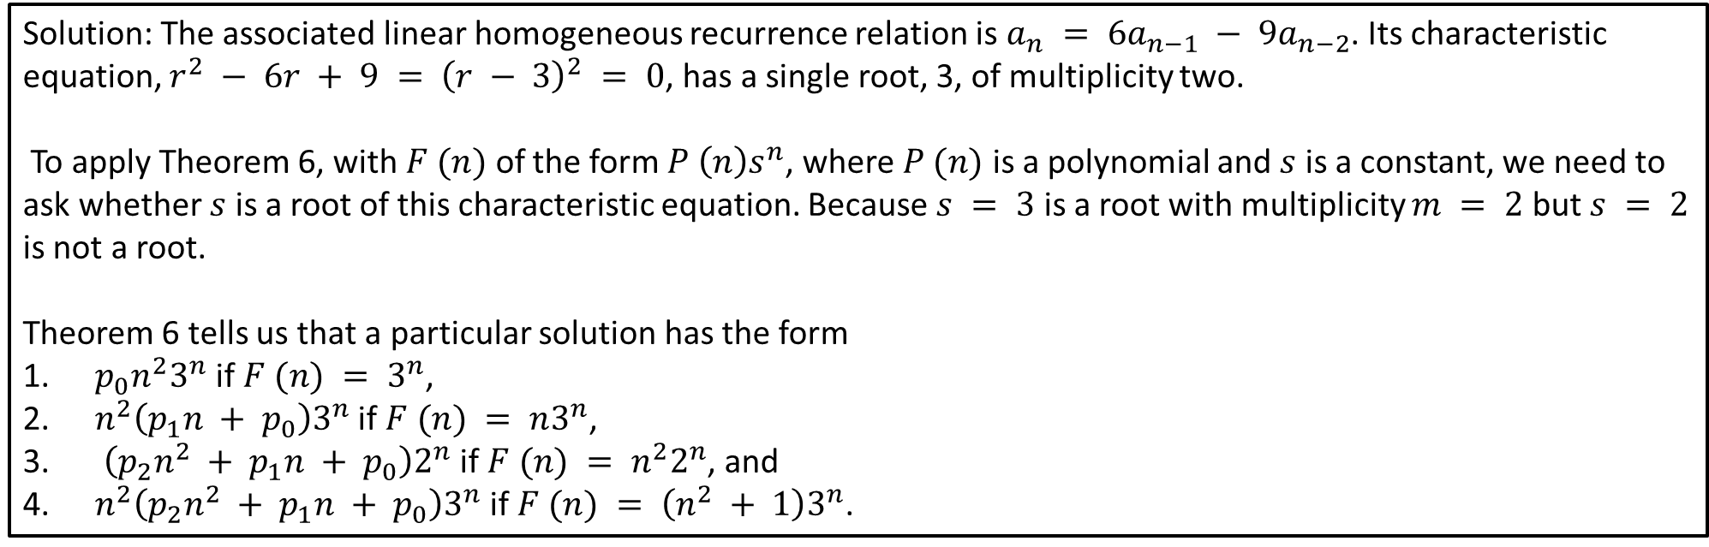
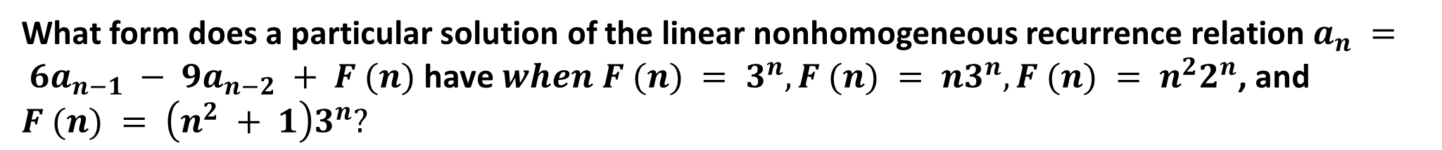
Example
What form does a particular solution of the linear nonhomogeneous recurrence relation $a_{n} = 6a_{n−1} − 9a_{n−2} + F (n)$have $when F (n) = 3^{n}, F (n) = n3^{n}, F (n) = n^{2}2^{n}$, and $F (n) = \left(n^{2} + 1\right)3^{n}?$
Solution: The associated linear homogeneous recurrence relation is $a_{n} = 6a_{n−1} − 9a_{n−2}$. Its characteristic equation, $r^{2} − 6r + 9 = {\left(r − 3\right)}^{2} = 0$, has a single root, 3, of multiplicity two.
To apply Theorem 6, with $F (n)$ of the form $P \left(n\right)s^{n}$, where $P (n)$ is a polynomial and $s$ is a constant, we need to ask whether $s$ is a root of this characteristic equation. Because $s = 3$ is a root with multiplicity $m = 2$ but $s = 2$ is not a root.
Theorem 6 tells us that a particular solution has the form
$p_{0}n^{2}3^{n}$ if $F (n) = 3^{n}$,
$n^{2}\left(p_{1}n + p_{0}\right)3^{n}$if $F (n) = n3^{n}$,
$\left(p_{2}n^{2} + p_{1}n + p_{0}\right)2^{n}$ if $F (n) = n^{2}2^{n}$, and
$n^{2}\left(p_{2}n^{2} + p_{1}n + p_{0}\right)3^{n}$if $F (n) = \left(n^{2} + 1\right)3^{n}$.

Slide 6
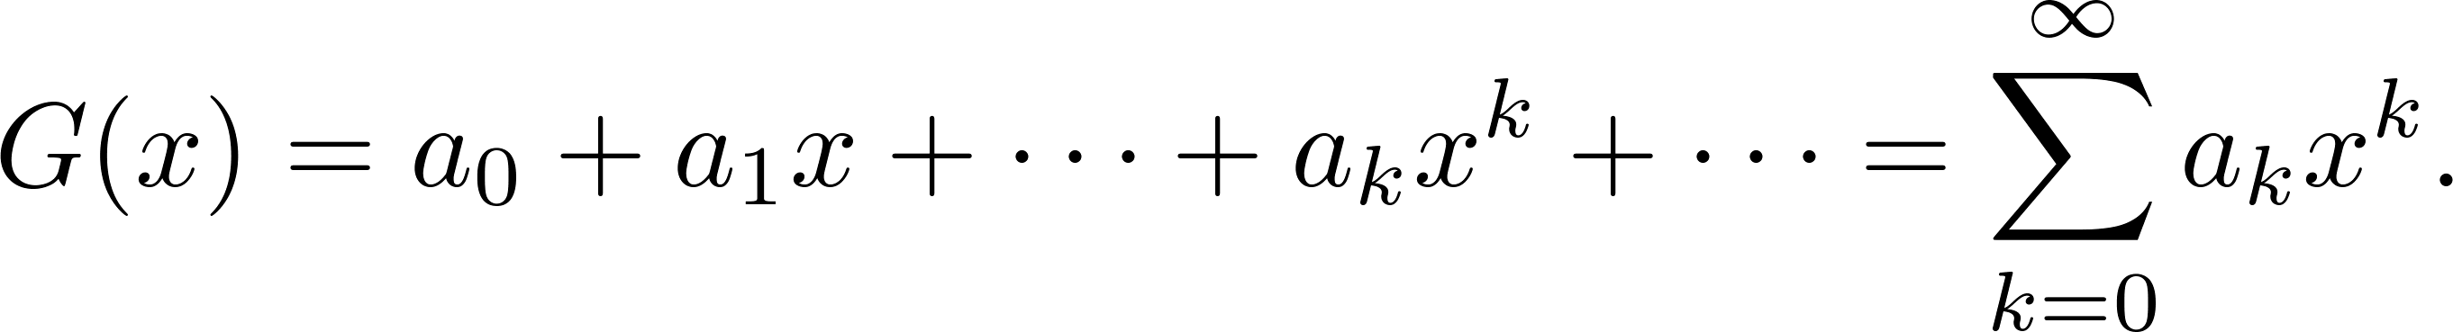
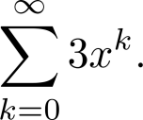
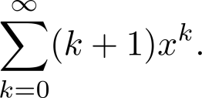
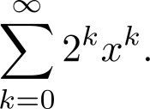
Generating Functions
Definition: The generating function for the sequence a₀, a₁,…, a_{k}, … of real numbers is the infinite series
Examples:
The sequence {a_{k}} with a_{k} = 3 has the generating function
The sequence {a_{k}} with a_{k} = k + 1 has the generating function has the generating function
The sequence {a_{k}} with a_{k} = 2^{k} has the generating function has the generating function

Slide 7
Generating Functions for Finite Sequences
Generating functions for finite sequences of real numbers can be defined by extending a finite sequence a₀,a₁, … , a_{n} into an infinite sequence by setting a_{n+1} = 0, a_{n+2} = 0, and so on.
The generating function G(x) of this sequence {a_{n}} is a polynomial of degree n because no terms of the form a_{j}x^{j} with j > n occur, that is,
G(x) = a₀ + a₁x + ⋯ + a_{n} x^{n}.

Slide 8
Generating Functions for Finite Sequences (continued)
Example: What is the generating function for the sequence 1,1,1,1,1,1?
Solution: The generating function of 1,1,1,1,1,1 is
1 + x + x² + x³ + x⁴ + x⁵.
we have
(x⁶ − 1)/(x −1) = 1 + x + x² + x³ + x⁴ + x⁵
when x ≠ 1.
Consequently G(x) = (x⁶ − 1)/(x −1) is the generating function of the sequence.

Slide 9
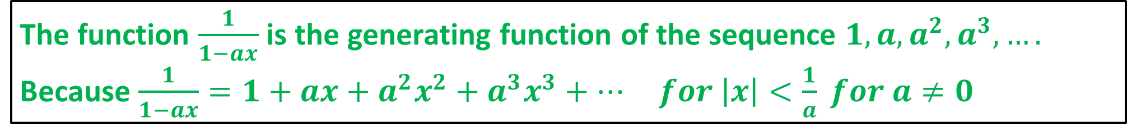
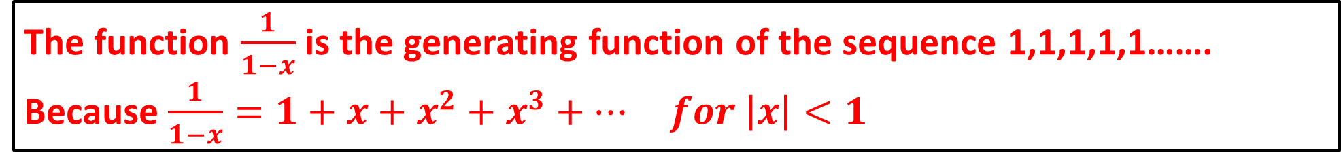
Useful Facts : Power Series
The function $\frac{1}{1−x}$ is the generating function of the sequence 1,1,1,1,1……. Because $\frac{1}{1−x}=1+x+x^{2}+x^{3}+… for \left|x\right|<1$
The function $\frac{1}{1−ax}$ is the generating function of the sequence $1,{a,a}^{2},a^{3},….$ Because $\frac{1}{1−ax}=1+ax+{a^{2}x}^{2}+{a^{3}x}^{3}+… for \left|x\right|<\frac{1}{a} for a≠0$

Slide 10
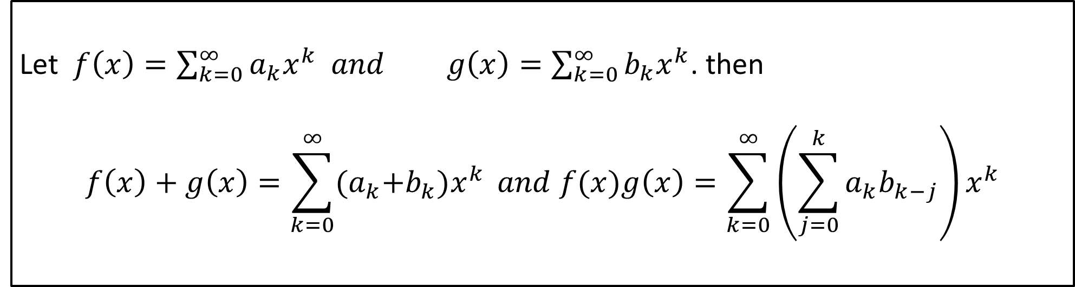
Theorem 1
Let $f\left(x\right)=\sum_{k=0}^{∞}{a_{k}x^{k} and }g\left(x\right)=\sum_{k=0}^{∞}{b_{k}x^{k}}$. then
$$f\left(x\right)+g\left(x\right)=\sum_{k=0}^{∞}{{(a}_{k}+b_{k})x^{k}} and f(x)g\left(x\right)=\sum_{k=0}^{∞}{\left(\sum_{j=0}^{k}{a_{k}b_{k−j}}\right)x^{k}}$$

Slide 11
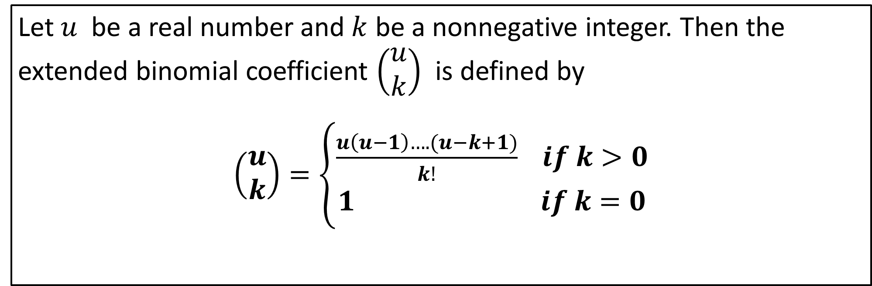
Extended Binomial Coefficient
Let $u$ be a real number and $k$ be a nonnegative integer. Then the extended binomial coefficient $\left(\begin{matrix}u \\ k\end{matrix}\right)$ is defined by
$\left(\begin{matrix}u \\ k\end{matrix}\right)=\left\{\begin{aligned}\frac{u\left(u−1\right)….(u−k+1)}{k!} if k>0 \\ 1 if k=0\end{aligned}\right.$

Slide 12
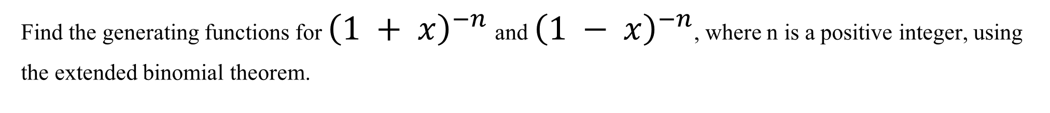
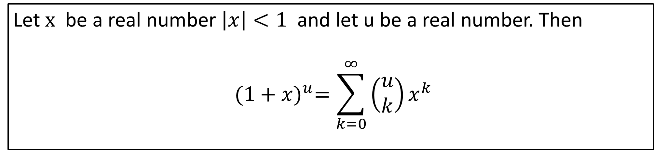
Theorem 2 : Extended Binomial Theorem
Let $x$ be a real number $\left|x\right|<1$ and let u be a real number. Then
$${(1+x)}^{u}=\sum_{k=0}^{∞}{\left(\begin{matrix}u \\ k\end{matrix}\right)x^{k}}$$
Find the generating functions for ${\left(1 + x\right)}^{−n}$and ${\left(1 − x\right)}^{−n}$, where n is a positive integer, using the extended binomial theorem.

Slide 13
Counting Problems and Generating Functions
Example: Find the number of solutions of e₁ + e₂ + e₃ = 17, where e₁, e₂, and e₃ are nonnegative integers with 2 ≤ e₁≤ 5, 3 ≤ e₂ ≤ 6, and 4 ≤ e₃ ≤ 7.
Solution:
The number of solutions is the coefficient of x¹⁷ in the expansion of
(x² + x³ + x⁴ + x⁵) (x³ + x⁴ + x⁵ + x⁶) (x⁴ + x⁵ + x⁶ + x⁷).
This follows because a term equal to is obtained in the product by picking a term in the first sum x^{e1}, a term in the second sum x^{e2}, and a term in the third sum x^{e3}, where e₁ + e₂ + e₃ = 17.
There are three solutions since the coefficient of x¹⁷ in the product is 3.

Slide 14

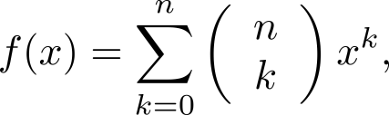
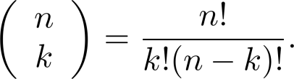
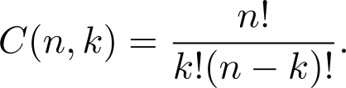
Counting Problems and Generating Functions
Example: Use generating functions to find the number of k-combinations of a set with n elements, i.e., C(n,k).
Solution: Each of the n elements in the set contributes the term (1 + x) to the generating function
Hence f(x) = (1 + x)^{n} where f(x) is the generating function for {a^{k}}, where a^{k} represents the number of k-combinations of a set with n elements.
By the binomial theorem, we have
where
Hence,

Slide 15
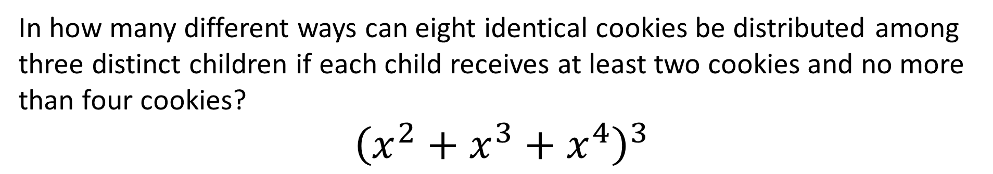
Counting Problems and Generating Functions
In how many different ways can eight identical cookies be distributed among three distinct children if each child receives at least two cookies and no more than four cookies?
$${\left(x^{2}+x^{3}+x^{4}\right)}^{3}$$

Slide 16
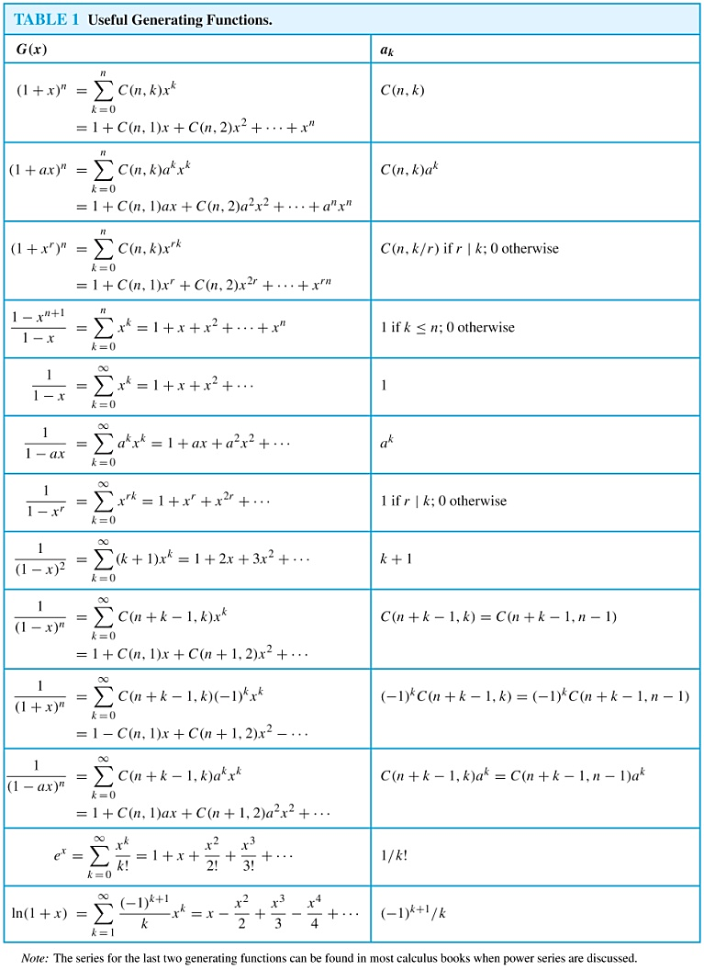
Useful Generating Functions

Slide 17
Useful Generating Functions

Slide 18
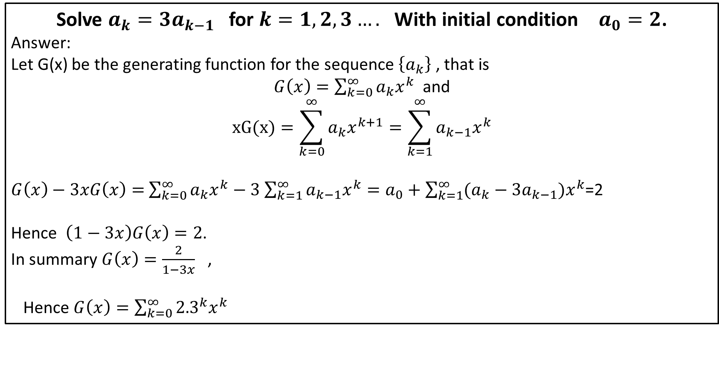
Solving Recurrence relation
Solve $a_{k}=3a_{k−1}$ for $k=1,2,3….$ With initial condition $a_{0}=2$.
Answer:
Let G(x) be the generating function for the sequence $\left\{a_{k}\right\}$ , that is
$G\left(x\right)=\sum_{k=0}^{∞}{a_{k}x^{k}}$ and
$$xG(x)=\sum_{k=0}^{∞}{a_{k}x^{k+1}=\sum_{k=1}^{∞}{a_{k−1}x^{k}}}$$
$G\left(x\right)−3xG\left(x\right)=$ $\sum_{k=0}^{∞}{a_{k}x^{k}−3}$ $\sum_{k=1}^{∞}{a_{k−1}x^{k}}=a_{0}+\sum_{k=1}^{∞}{(a_{k}−{3a}_{k−1})x^{k}}$=2
Hence $\left(1−3x\right)G\left(x\right)=2$.
In summary $G\left(x\right)=\frac{2}{1−3x}$ ,
Hence $G\left(x\right)=\sum_{k=0}^{∞}{{2.3}^{k}x^{k}}$

Slide 19
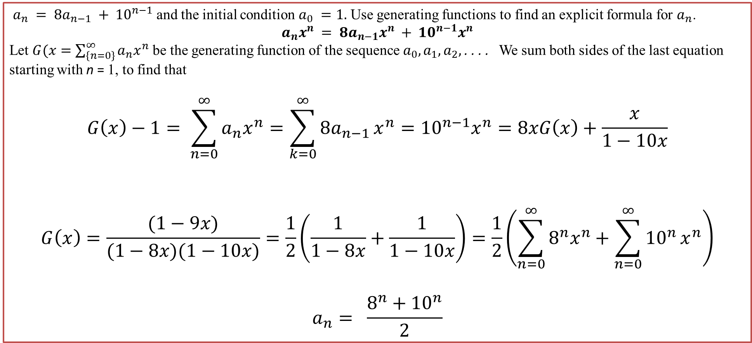
Solving Recurrence relation
$a_{n} = 8a_{n−1} + {10}^{n−1}$and the initial condition $a_{0} =1.$ Use generating functions to find an explicit formula for $a_{n}$.
$$a_{n}x^{n} = 8a_{n−1}x^{n} + {10}^{n−1}x^{n}$$
Let $G(x=\sum_{\left\{n=0\right\}}^{∞}{a_{n}x^{n}}$ be the generating function of the sequence $a_{0}, a_{1}, a_{2},$. . . . We sum both sides of the last equation starting with n = 1, to find that
$$G\left(x\right)−1= \sum_{n=0}^{∞}{a_{n}x^{n}}=\sum_{k=0}^{∞}{8a_{n−1}}x^{n}={10}^{n−1}x^{n}=8xG\left(x\right)+\frac{x}{1−10x}$$
$$G\left(x\right)=\frac{(1−9x)}{(1−8x)(1−10x)}=\frac{1}{2}\left(\frac{1}{1−8x}+\frac{1}{1−10x}\right)=\frac{1}{2}\left(\sum_{n=0}^{∞}{8^{n}x^{n}+\sum_{n=0}^{∞}{{10}^{n}}x^{n}}\right)$$
$$a_{n}= \frac{8^{n}+{10}^{n}}{2}$$

